Slide 1



Emotional Wellbeing Teams in Schools
(EWTS)
A Programme of support for Post-Primary Schools
Dr Theresa McShane (SPPG DoH)
Regional Coordinator for Emotional Wellbeing Teams in Schools

Slide 2
What’s the problem and what difference can schools make?
The problem
Mental health problems 25% higher here than England, Scotland and Wales
Services being overwhelmed
Schools have an important part to play
Poor mental heath can affect educational attainment
Ability to form positive relationships
Leading to increasing isolation and sense of unhappiness
Threatening future opportunities and roles in society
A child or young person’s ability to engage with school and the opportunities it affords can be impacted upon by their sense of wellbeing, personal agency, resilience and ability to seek help
Notes:
As documented in various sources, for example. The most recent NI Youth Wellbeing Prevalence survey and the still waiting report, the mental health of our young people if of concern.
As well as this, taking an average over the past 5 years the CAMHS dataset figures indicate that approximately 30% of all referrals received into CAMHS don’t meet the standardised clinical referral criteria.
This highlights that there is a population of children who referrers believe could benefit from CAMHS intervention but when triaged by the service are not suitable.
All these young people have an emotional wellbeing need nonetheless, and The Emotional Wellbeing Teams in post primary schools is CAMHS contribution to the children and young people’s emotional health and wellbeing in education framework.
These will be dedicated teams that will work with schools to provide the following CORE OFFER

Slide 3

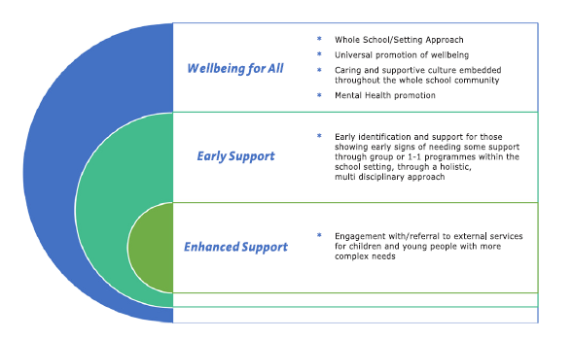
The Background
Framework Aims
Children and young people are empowered to manage their own emotional health and wellbeing
Their needs are identified early and addressed effectively when required
Development of an integrated model of support
Fewer require specialist intervention from mental health services
DE Wellbeing in Education Framework – Model of Support
Notes:
Framework aims …

Slide 4
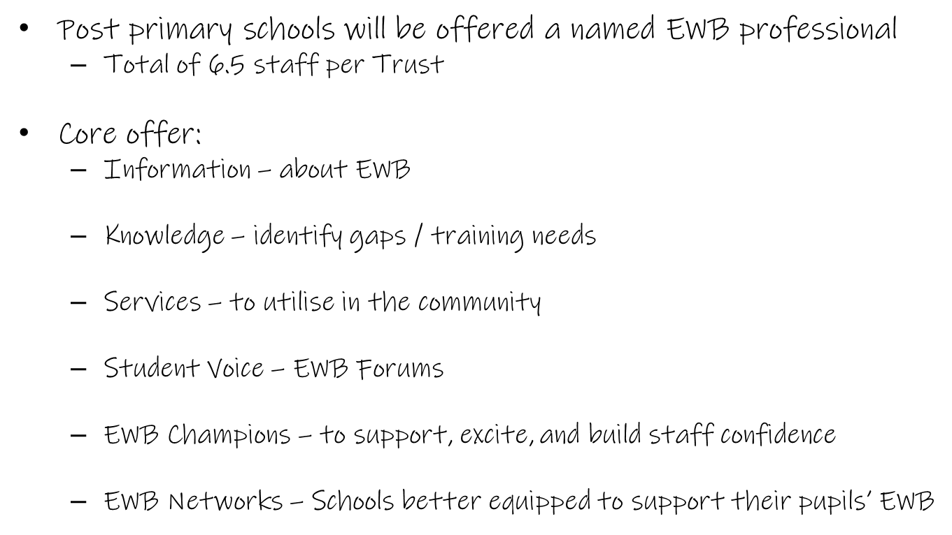
The Teams
Bespoke to individual schools
Educational sessions delivered to pupils (in groups)
Training sessions delivered to teachers

Slide 5
Progress to date
Staff Recruitment
  32.5/33.5 in post
Schools
  88 EOIs for capacity 48
  MOUs
  Implementation planning meetings
Baseline data
  School questionnaire (capture complete)
  Pupil voice questionnaire (commenced)
Priority areas
Teachers
Anxiety
General mental health and emotional wellbeing
Resilience
Self harm
Pupils
Anxiety
General mental health and emotional wellbeing
Bullying
Lack of confidence
Resources
  Page Tiger
  Canva for Teams
  Promotional materials

Slide 6




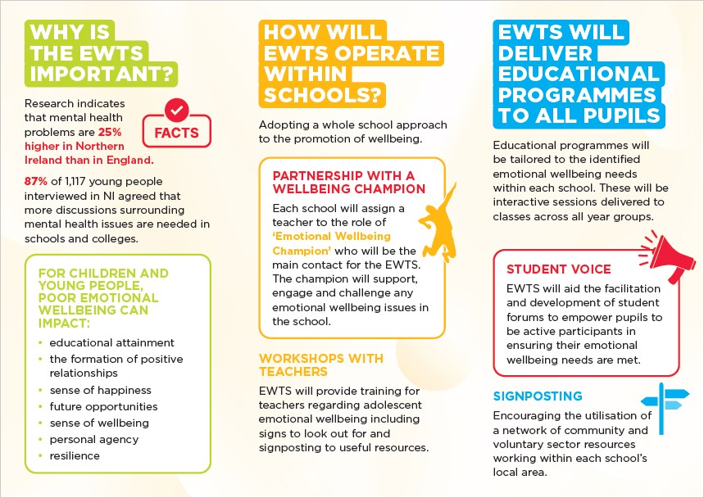
Promotional Materials
Teacher Flyer
School Poster
Pupil Bookmark

Slide 7
Questions?
For further information
EWTS Trust areas, please contact:
Belfast and South Eastern Trust: EWTS@belfasttrust.hscni.net
Northern Trust: EWTS@northerntrust.hscni.net
Southern Trust: EWTS@southerntrust.hscni.net
Western Trust: EWTS@westerntrust.hscni.net
EWTS Regional Coordinator | Dr Theresa McShane | SPPG | Theresa.mcshane@hscni.net

